Slide 1
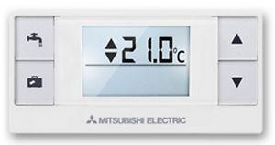
How to control your central heating
Mitsubishi Ecodan Heat Pump
1. Displays selected room temperature
(changes when you press up/down arrows
Press to increase room temperature
18.0c
Press to reduce room temperature
2. Displays current room temperature
(Like a thermometer)
If the selected temperature (1) is lower than the current room temperature (2), the heating will not come on, as your home is already warm enough.
Once you have found the temperature that you like, you should not need to adjust the temperature again. Most people have the heating set somewhere between 18°C and 21°C, but this is up to you.
In summer, if you want make sure that the heating doesn’t come on, turn the temperature down to 10.0°C using the down arrow.
Remember to turn up the selected temperature towards the end of summer though.
If you have any issues with your heating, or if an error code appears on the controller, you will need to contact Stroud District Council (01453 754 852) to arrange for an Engineer to visit to adjust this.

